Slide 1
Useless Lockbox
Team 09
Daniel Diaz
Dwayne Hoeck
Ha Tran
Thanh Le

Slide 2
Need and Motivation
Need:
Privacy and security have become major concerns in society today. Whether it be a teenager trying to keep a diary hidden or an adult keeping money away from a less than trustworthy roommate, a lockbox is a good way to go.
Unfortunately, lockboxes are obvious and sometimes bring with them curiosity as to what is inside. An interesting and elegant way to keep a lockbox without arousing much suspicion is needed.
Motivation
Privacy
Entertaining
Not identifiable as lockbox at first glance
Environmentally friendly
Aesthetically pleasing

Slide 3
Objective
The overall objective of this project is designing and prototyping an elegant lockbox. The locking feature should not be the most distinguishing feature yet still be a secured box of storing items.
Design
PCB
Unlock program
Box
Prototype
Hardware box
Test
Input correct code/unlocks/disable
Input incorrect code/disable
Input admin code to change access code

Slide 4
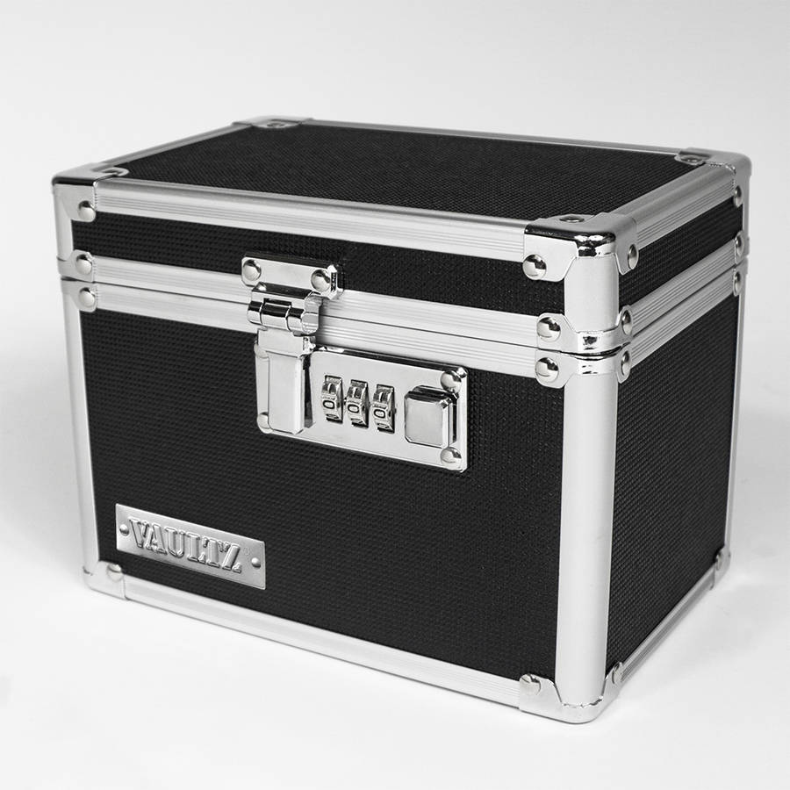
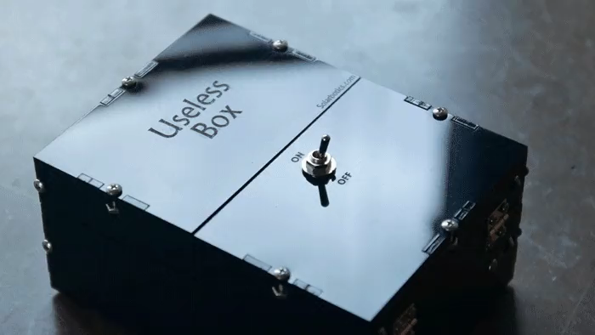
Alternatives
Conventional lock box
Conventional useless box

Slide 5
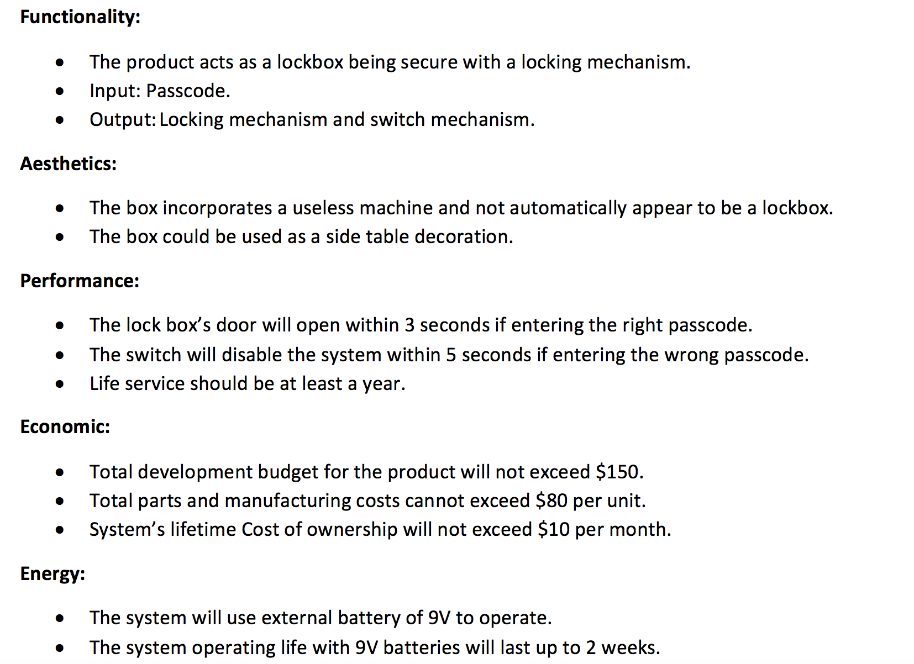
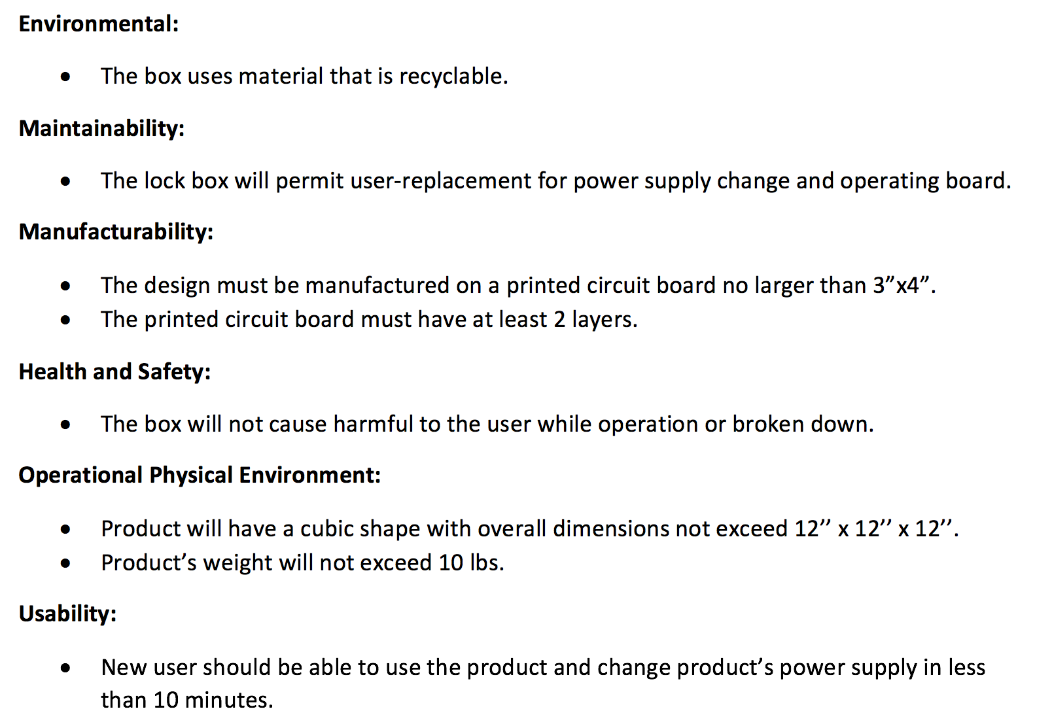
Requirements

Slide 6
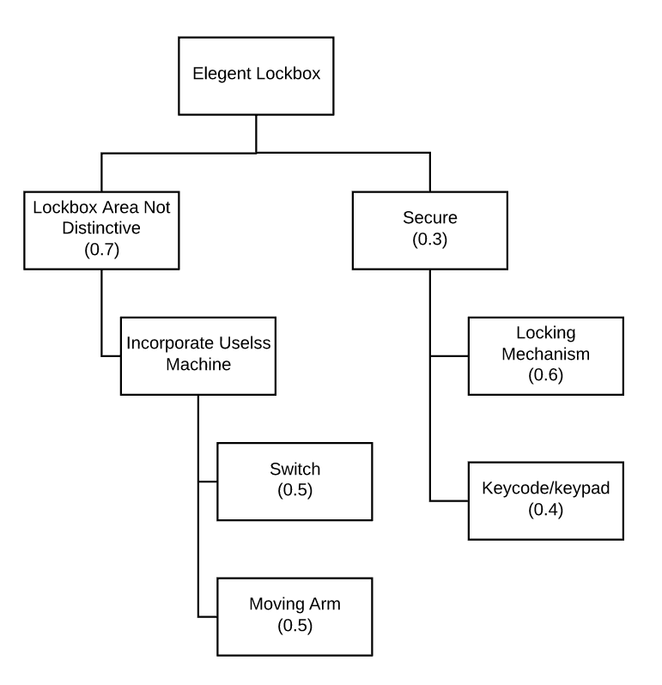
Approach
Useless machine feature incorporation: Simple box with a switch and a moving arm. When the switch is flipped, the arm moves and flips the switch back to the starting position.
Lock box feature: The switch will enable a keypad. If the correct passcode is entered a solenoid will activate and the “hidden” lockbox compartment will open. If the passcode is incorrect a moving arm will flip the switch back to the off position.

Slide 7
Approach
Split hardware and software
ATmega328P microprocessor interactions:
LCD
Keypad
Servo
Solenoid
Switch
Hardware
Box/Door
PCB

Slide 8
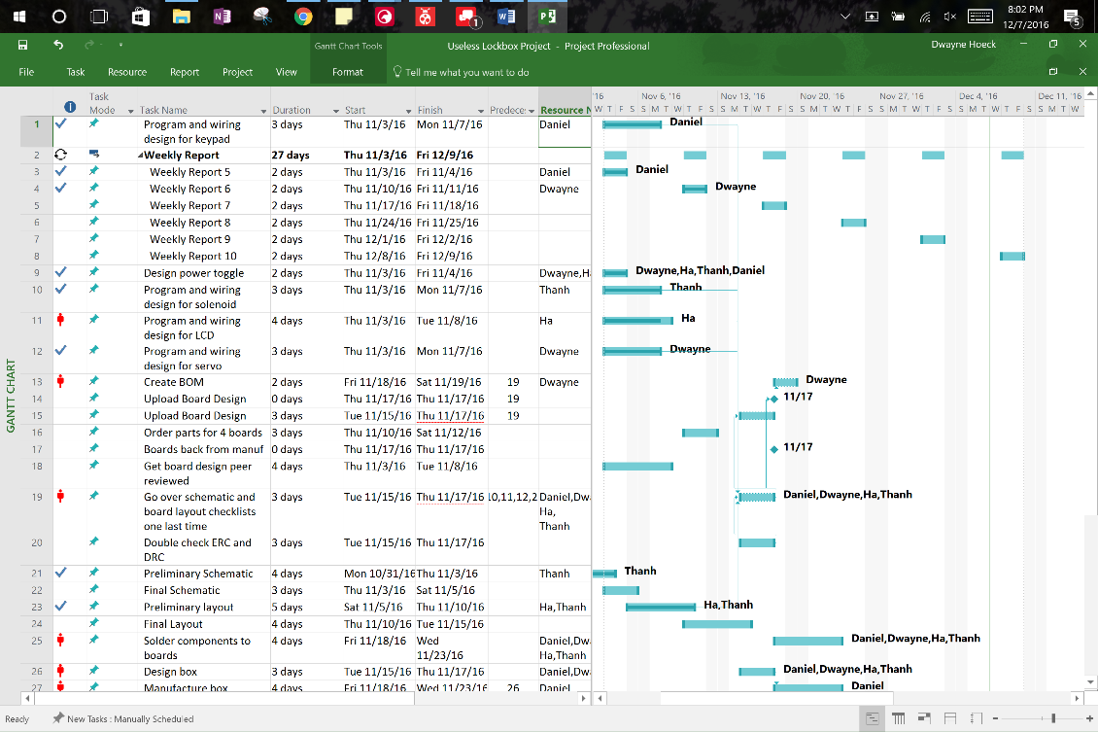
Project Schedule
Easy to use
Free
Shareable
Well-known
Easily Accessible

Slide 9
Design Process
Atmega328P IDE:
Atmel studio + AVR Dragon
Software coding:
LCD: 4 bits interactions
Servo: 16bits counter and interrupt service to produce PWM
Keypad: matrix keypad
Hardware:
PCB: Eagle and Oshpark
Box: SOLIDWORK and Laser cutter in L.I.D

Slide 10
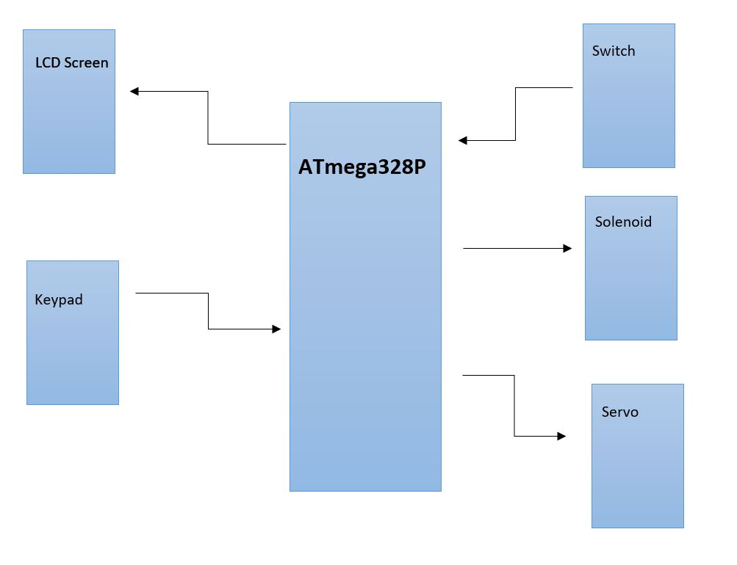
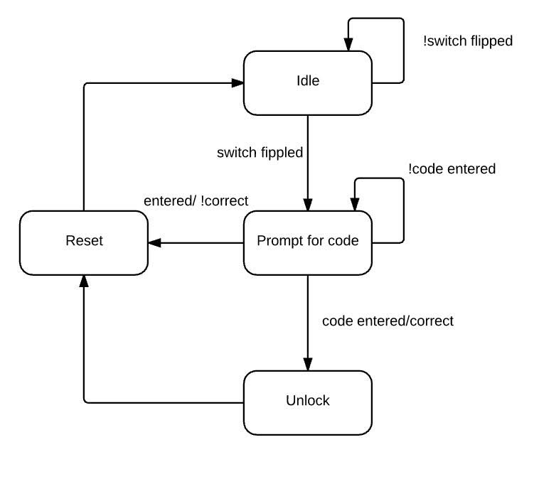
Design Process– Block Diagram

Slide 11
Design Alternatives and Decision Making
Design alternative
Atmel studio vs Arduino IDE
4-bit vs 8-bit interaction for LCD
Interrupt vs pull-up GPIO for keypad
SOLIDWORKS vs Adobe Reader for box design
3D-printing vs Laser-cutter for box prototype
Decisions made
Atmel studio:
Available in lab
Debugging ability
4-bit interaction for LCD:
I/O pins saving
Pull-ups GPIO for Keypad:
Interrupts mean more complex code
SOLIDWORKS: More flexible
Laser-cutter:
Faster
Easy to fix

Slide 12
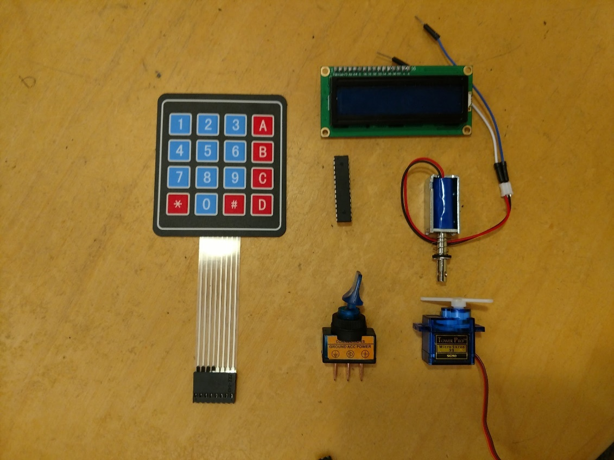
Implementation
Major components:
Microprocessor: ATmega328P
Locking Mechanism:
Key Pad
16x2 LCD Display
Solenoid
Useless Box Mechanism:
Switch
Servo

Slide 13
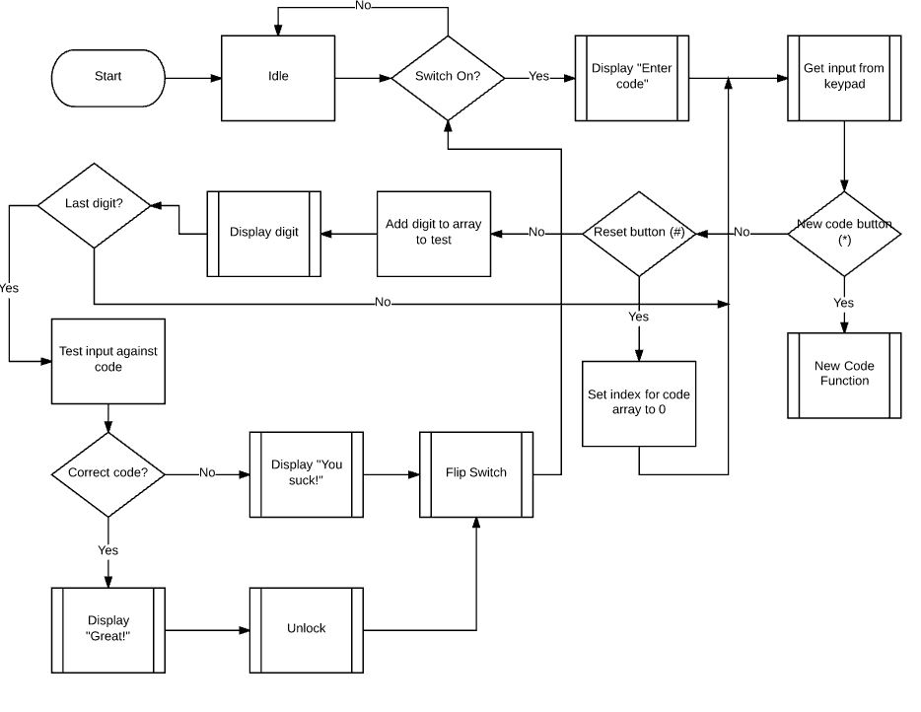
Implementation - Coding

Slide 14
Implementation - Pseudo code
While switch on
Ask for 4-key number code
If the code is the pass code: open the box, flip the switch
Else If the code is the reset code: run the reset sequence
Else if the code is admin code: run the change sequence
Else flip the switch

Slide 15
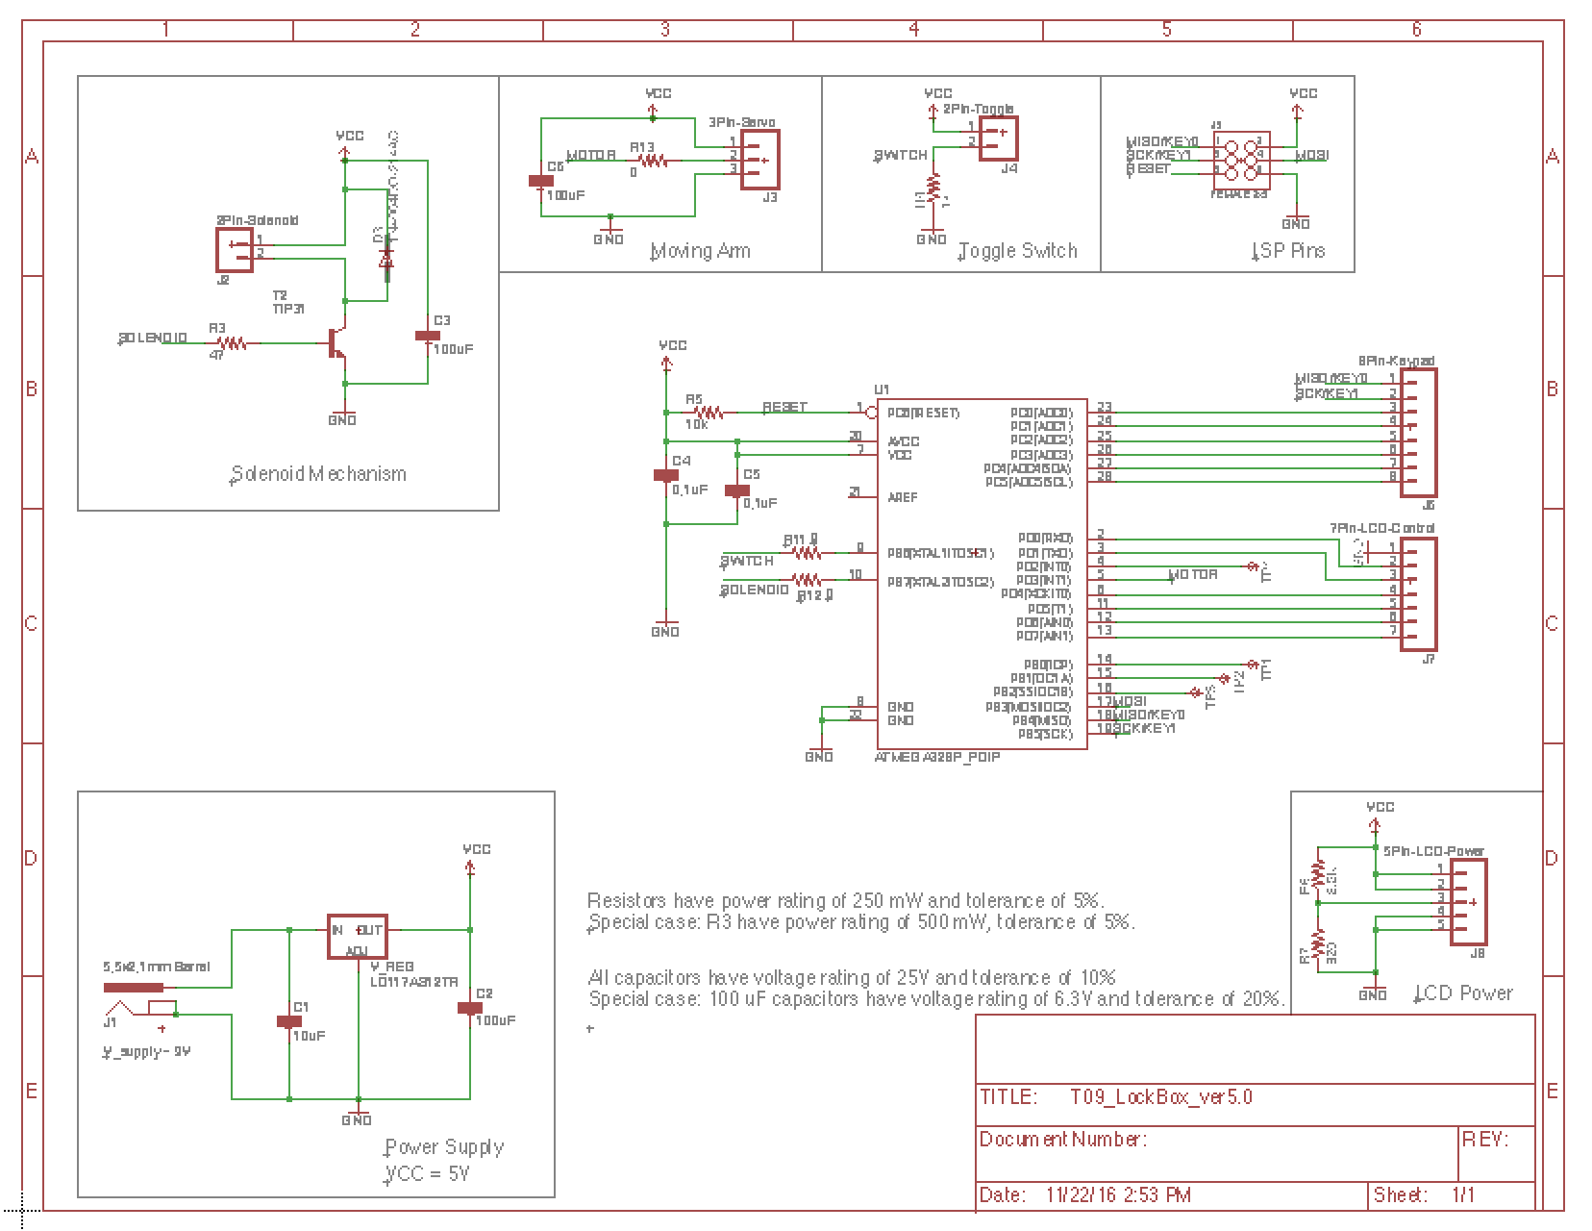
Implementation - Schematic

Slide 16
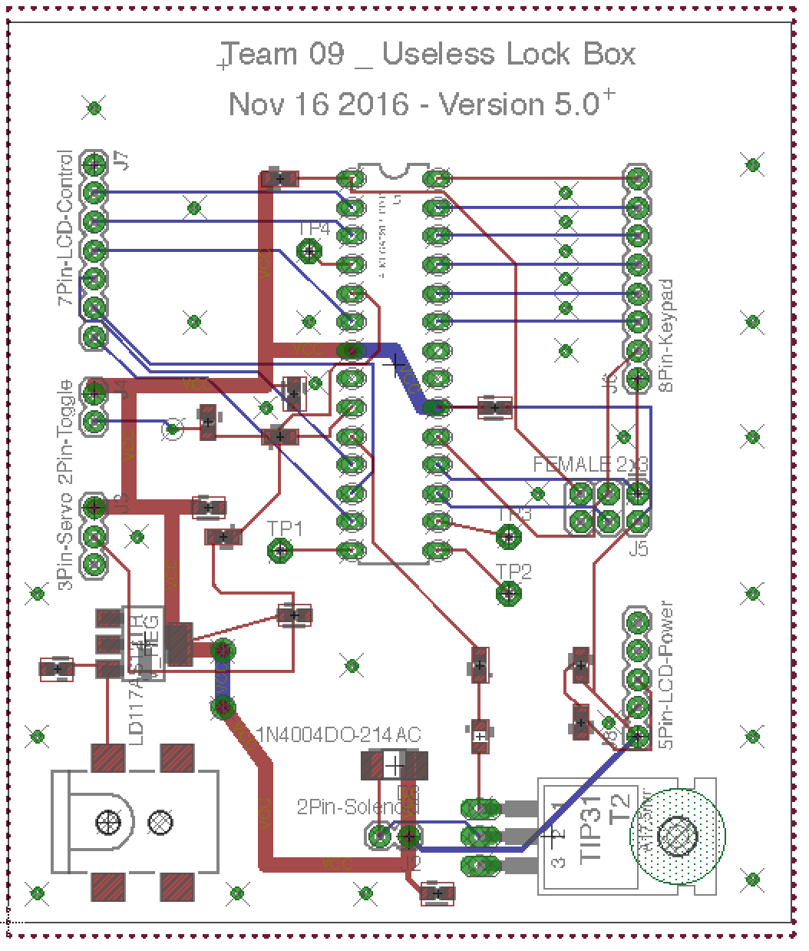
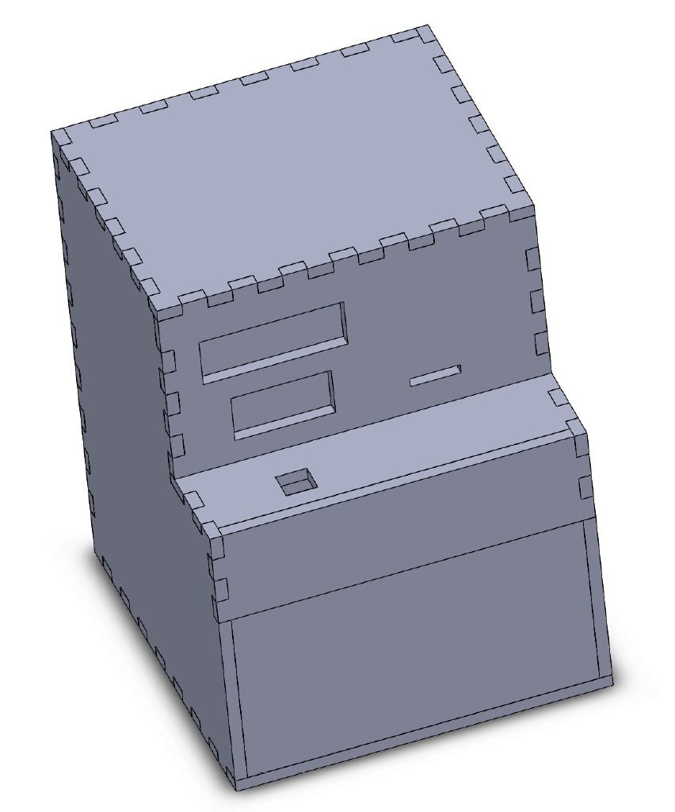
Implementation - Board Layout and Box Model

Slide 17
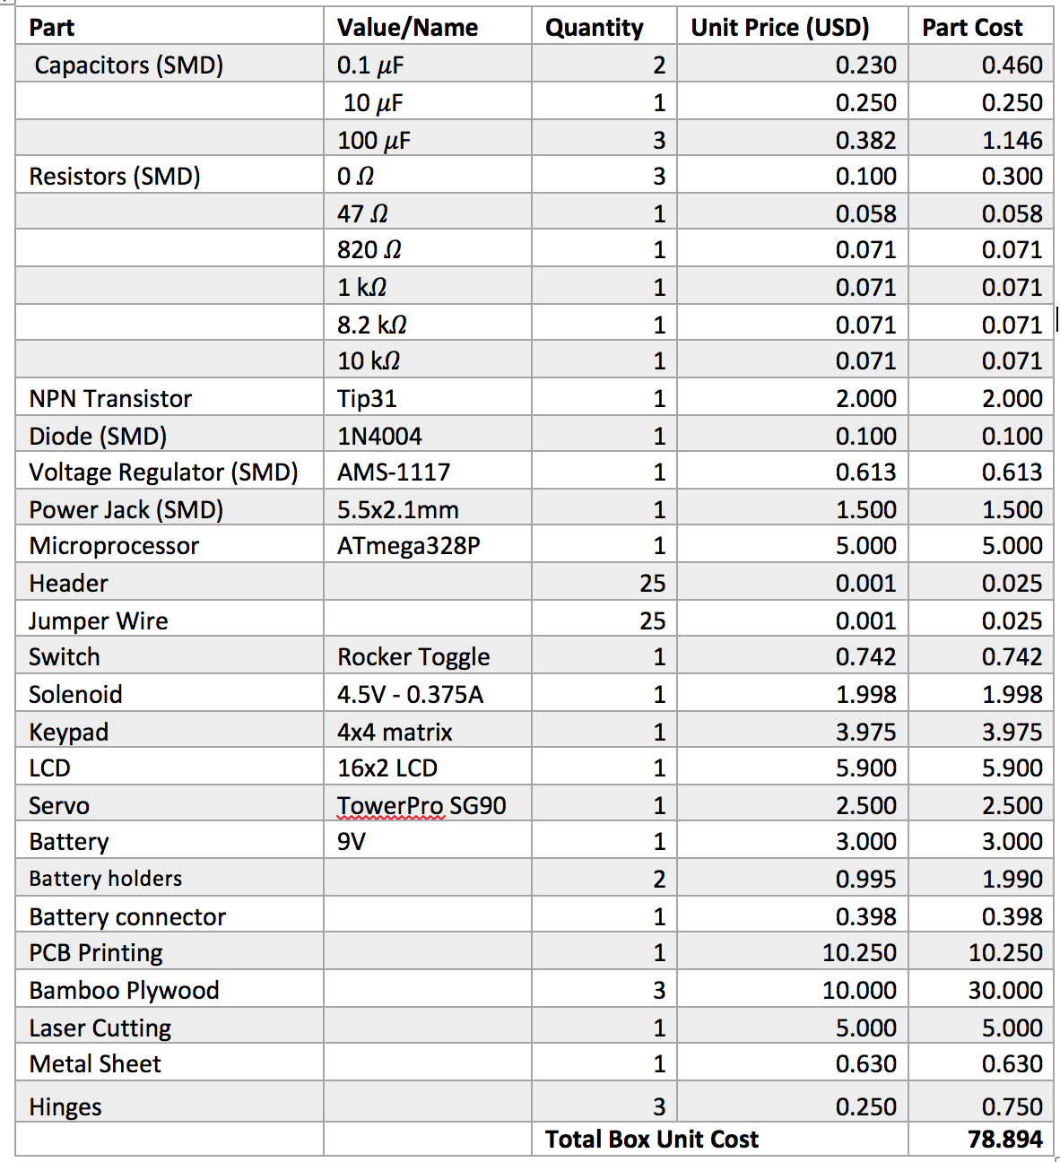
Implementation - Bill of Materials

Slide 18
IP and Prior Work
Useless box: Originally designed in 1930s by Italian artist Bruno Munari. The most famous useless box began in 1952 at Bell Labs by Marvin Minsky.
Lock box: The first modern lockbox was invented over 55 years ago by Delbert Williams.

Slide 19
Testing plan
Individual modules testing: servo, keypad, LCD, switch
Integrations test: Correct code/ Admin code/ Incorrect code enter
Acceptance test: does it meet the condition is PDS
Privacy
Entertaining
Environmentally friendly
Authenticity
Economic
Operational physical environments

Slide 20
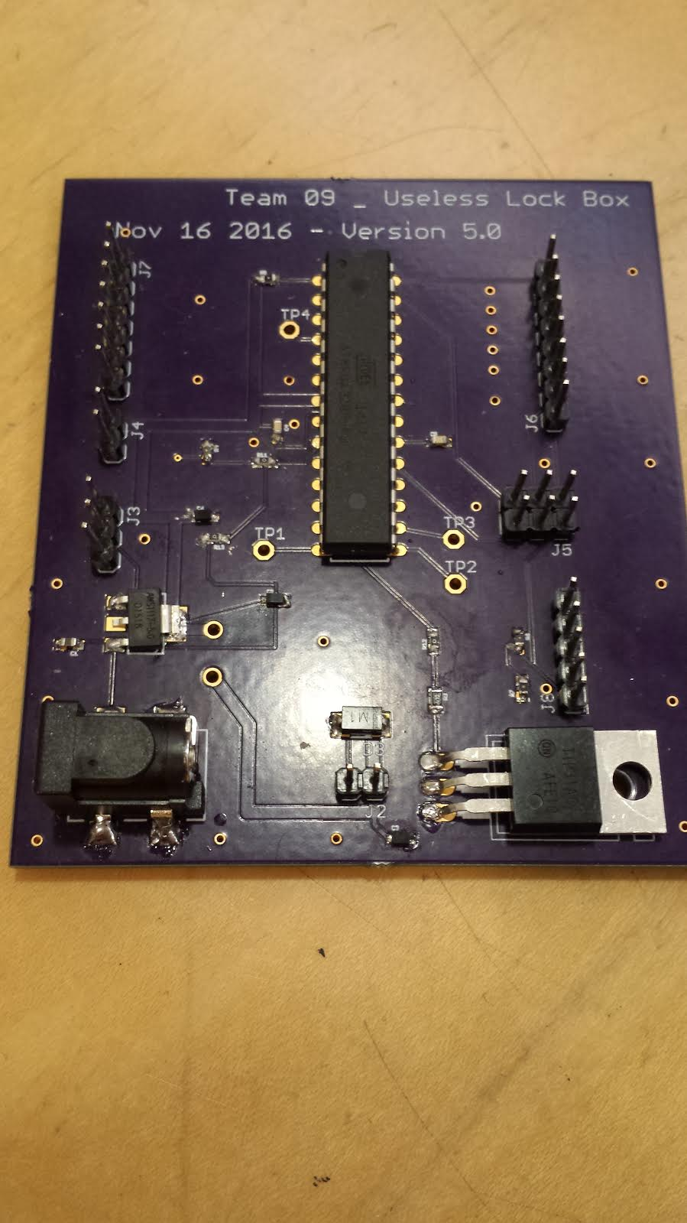
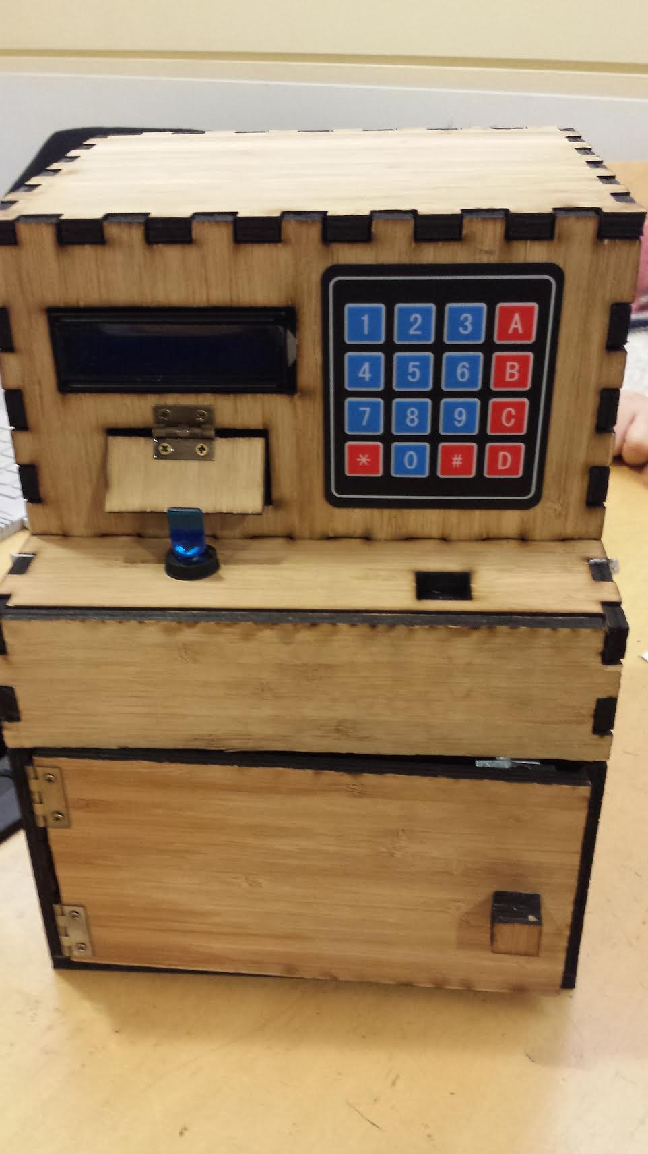
Result
A lock box and four working PCBs

Slide 21
Contributions and Lessons Learned
Contribution: All members are involved in the whole design process.
Box printing
Schematic/PCB
Coding
Testing
Writing
Lessons learning: Each team member learns more on working in team.
Brainstorming process
Designing
Decision making
Issues troubleshooting
Documentation
Communication

Slide 22
Thank you

